Slide 1
Social Media Marketing for Asphalt Companies
2014 Alabama Asphalt Pavement Conference
T. Carter Ross, Vice President for Communications, National Asphalt Pavement Association, Lanham, Maryland
Notes:
Good afternoon and I want to thank the Alabama Asphalt Pavement Association for inviting me to speak today. I’m T. Carter Ross, vice president for communications for the National Asphalt Pavement Association. Before joining NAPA, I spent about 20 years in media and publishing, and I helped devise digital strategies for several trade newspapers in the radio and broadcasting fields.
Before we get started, can I get a quick show of hands: How many people here are on Facebook personally? And how many have a corporate presence on Facebook or other social media? Okay … thanks. I may be covering some ground that you already know, but if you have questions at the end, I’d be happy to try to help answer them.

Slide 2
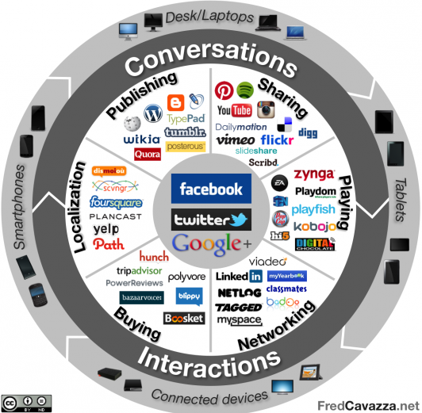
What is Social Media?
Source: FredCavazza.net
Notes:
Let’s start today by defining the term “Social Media.”
“Social Media” or “social networking” encompasses Facebook, Twitter, Instagram, Pinterest, LinkedIn, and a wide range of networks and tools that barely existed a decade ago. The first real social network, Friendster, launched in 2002; LinkedIn and MySpace followed a year later in 2003. Ten years ago, in 2004, Facebook made its debut. New social media networks keep being developed and old ones reinvent themselves or fade away. It’s hardly a static medium
Beyond these sorts of websites, social media can also be used to refer to blogging, review sites, online video, and more -- anything that serves to create connections among people.

Slide 3
What is Social Media?
26% of all time Americans spend online is spent on social networking sites. With smartphones, that number increases.
9 out of 10 online adults said they access social media monthly.
And most of them (64%) access social media sites daily.
And about 3 of every 5 minutes spent on social media is spent on Facebook alone
… and those numbers are growing ...
Sources: Experian Marketing Services, 2013 Digital Marketer Report Nielsen, The Digital Consumer (2014)
Statistic Brain
Facebook Newsroom
Notes:
According to Experian Marketing Services, out of every hour Americans spent online in 2013, 16 minutes was spent using social networking sites. That’s about 26% of their time online. And if they use a smartphone, then the time spend on social media increases to greater than a third of the time they spend online.
On average, Americans spend about 25 and 1/4 hours a month on social media, and about 14 and 3/4 of those hours – about three out of every five minutes spent with social media – is spent on Facebook.
Looking at it another way, Facebook has 1.23 billion monthly active users worldwide. Now, only 19% of them are in the U.S. and Canada, but that still works out to nearly 234 million people, 67% of the population of those two countries, who are active users of Facebook each month. The uptake of Facebook as leveled off some in the U.S. over the past two years, but the number of users continues to grow.
It’s a lot of numbers, but what does it mean for you?

Slide 4
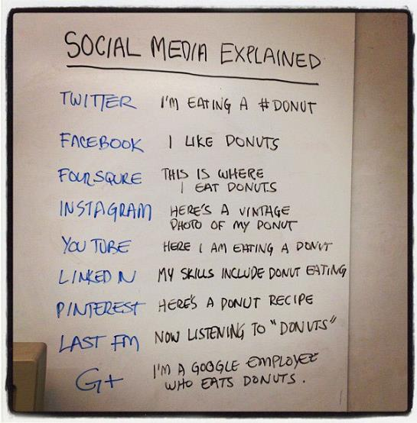
Source: Three Ships Media, http://www.threeshipsmedia.com/social-media-and-donuts/
Notes:
Well, in simplest terms, social media or social networking is a simple way to keep in touch with friends, family, clients, colleagues, and the public at large. It’s also a rather fragmented space. There are a lot of apps and networks, and you reach different people in each of them in different ways.
This image sums up most of the currently popular social media outlets quite well, illustrating how each is different and used in a different way. Twitter is generally quick news, Facebook is bit more about you, Foursquare is about where you are, Instagram is about photos … and so forth.
So, as the doughnut example illustrates, there are a ton of outlets and networks lumped together under the label of “social media” … and they are used by different people in different ways.

Slide 5
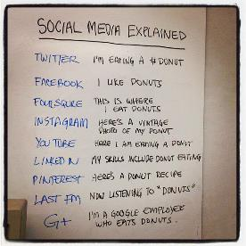
It’s About Connections
Social Media is many channels ... used in different ways.
Social Media is a connection … people follow you for a reason.
Social Media is a form of permission marketing … don’t disappoint those who’ve let you into their digital lives.
Notes:
When you’re looking at how to use social media for business – whether you’re selling food or clothing or asphalt – you need to get an idea of where the people you want to reach are, and how they’re using those networks, and then figure out how that fits into your plans.
It’s also important to remember that in most instances social networking is a two-way street. If someone likes your Facebook page, they’ve publically associated themselves with you and your company; they’re letting your posts appear in their newsfeed, and, unless they’ve set their privacy settings higher than most people bother to do, any interaction they have with you is visible to their friends.
When it comes to marketing, social media is a form of permission marketing. People have to actively agree to associate with you -- like you on Facebook, follow you on Twitter, and so forth -- and they generally do so because they want something, usually information or some sort of connection or association. Sometimes, they’re looking for affirmation or a conversation. If you put an ad in the newspaper or on a billboard, people are just going to encounter as they go about their lives; with social media, they’ve sought you out for one reason or another ... you don’t want to disappoint them.

Slide 6
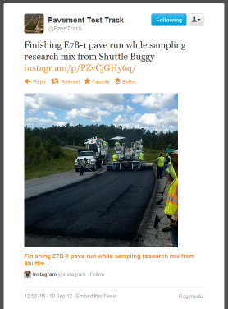
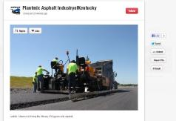
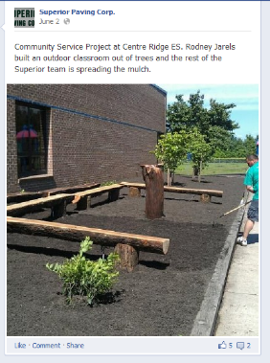
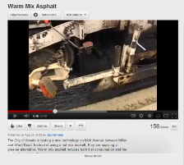
It’s About Communicating
Notes:
So how does this apply to an asphalt company? What can you do to draw in those connections and make them valuable to your company? First off it’s important to note that quantifying a return on investment with social media is difficult at best. It’s part of a broad marketing plan; not a standalone effort. Social media is a lot like attending an in-person networking event. You may leave with a new contact or idea, but not a signed contract. However, the impression or connection you make at that event could end up benefiting you in future months.
It’s about that public face, having people see your company as a valuable part of the community who makes their lives better. If you have an open house, community service events, or other public outreach efforts, social media can help promote the event, as well as to share what happens during the event.
You can also give people a behind-the-scenes look at what goes on in an asphalt plant or at a paving project, which can be helpful in correcting misperceptions people may have about what actually goes on when asphalt is produced or placed.
It can also be a way to get the word out about new technologies, such as warm mix or porous asphalt, and to correct misperceptions about the environmental impact of asphalt pavements or asphalt mix production.

Slide 7
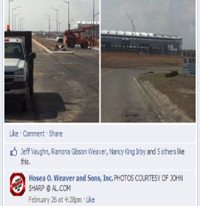
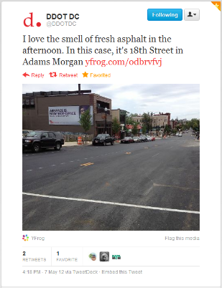
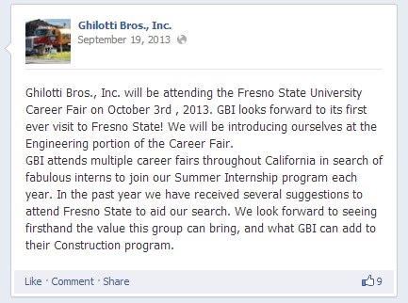
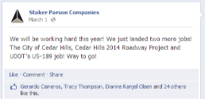
It’s About Networking
Notes:
But it’s not just a one-way medium. You can tell people about what you’re doing, but the hope is that others will share what you post, extending your reach and influence.
For example, if you post project updates to Twitter or Facebook, or blog about projects and then share links to that blog entry, that’s the sort of information that can be helpful to the public and is something that DOTs, public works agencies, traffic reporters, and others. Do it regularly, and those folk are likely to follow you to stay up to date about projects, which keeps your name in front of people you want to reach.
It’s also a valuable tool for human resources. If your employees like your company on Facebook, it’s a way to share information with them. And given how many people are on social media, posting that you are hiring or are looking for talent should be part of your strategy for building your workforce.

Slide 8
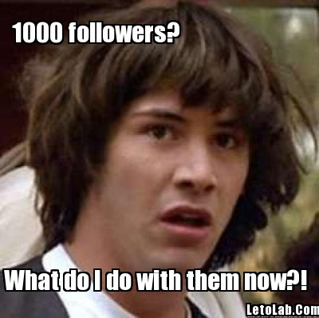
Notes:
But what does it really mean for your business? Why should you care about all this Facebook or Twitter stuff. Well, as I said earlier, about 40% of Americans use Facebook every day. Are they all your customers? No. A lot of them aren’t looking for a business connection, they just want to share silly pictures. But even if not everyone is looking for information about asphalt, some of them are.

Slide 9
Make the Case
What’s does this mean for my company?
How will I use it interact with the public?
Who is going to manage it?
How will I gauge success?
Notes:
Social media is like any other part of your business: You shouldn’t invest heavily if there isn’t a good business case. You don’t buy a new paver just because it’s a new year; you buy one because you need it to get the work you have and the work you want to have done. It could because an existing one is too inefficient, or because a change in technology makes the new one that much better, but it’s not something done on a whim.
If you get a cold call from a sales guy at a local radio station or a billboard company. Are you going to buy an ad if you don’t think it will help your business? No. The same with social media, it has to fit in with your broader marketing efforts and with your overall business strategy.
You don’t have to have answers to each of these questions, but you need to have an idea of where you’re going.
This is something that requires attention and resources. As I said earlier, social networks can be a valuable way to communicate with customers, regulators, employees, and your community, but make sure you are realistic about what expect to get out of it.

Slide 10
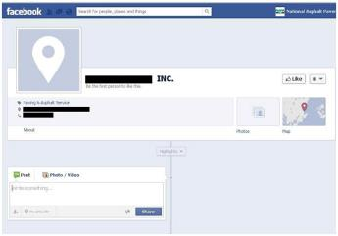
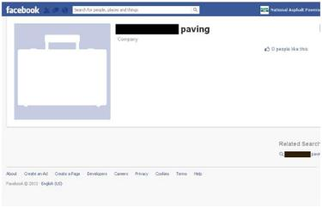
You May Already Be on Facebook
Notes:
As you think over that, I want to point out one other thing: Even if you don’t think there is a good business case for your company to be on Facebook, take a moment and check … because you may already be on Facebook.
These are actual paving companies I found on Facebook by searching for a city name and the word paving or the phrase “and sons paving”. There were a number of other ones I could have pulled, and I’ve blacked out the names just to keep them anonymous.
Basically, when Facebook decided to add a location-based check-in feature to its mobile app, it collected a lot of information from telephone directories and other sources to create those locations. Companies have the ability to claim a place and then to flesh out the information there, or they can create a page that is then used by Facebook Places. Similarly Facebook loves to take the information people give it and try to build out a bigger picture of them, their friends, and their habits. That data is key to how Facebook makes its money, and so they try to do as much as they can with it without violating the privacy policies they’ve established. So if you have a handful of employees who use Facebook, and they list XYZ Paving as their employer, Facebook can see that there’s a group of people, all living around Mobile, for example, that work for the same company, it will connect that information with the other data it has to create a skeleton page for a company.
It’s a best practice for reputation management, even if you don’t want to bother with Facebook, to check and see if you are represented on Facebook and if the information on the page is correct. It’s also worth occasionally googling your company to see if there are other places you’re appearing online unbeknownst to you.

Slide 11
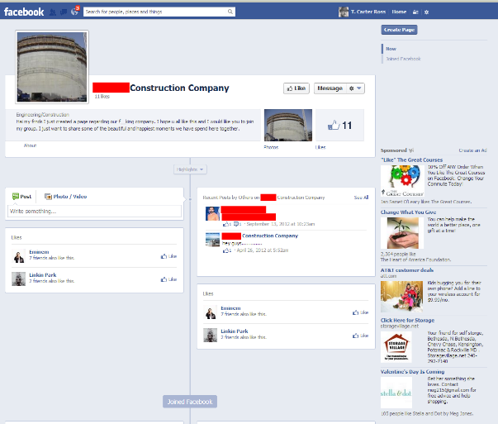
You May Already Be on Facebook
Notes:
Then there’s a situation like this. If you don’t have an official Facebook page that you control, it’s possible that some well-meaning employee, not really thinking things through, may create a page himself to use as a hangout for coworkers or friends. You should really be the one in control of your company’s identity online. Even if you don’t plan to make active use of a social media outlet, especially Facebook, make sure that someone else isn’t trying to fill the void.
So getting back to that business case for being on social media. The first reason to set up a Facebook Page is so that you can be the one who is in control your company’s image on Facebook.

Slide 12
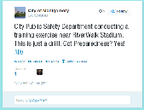
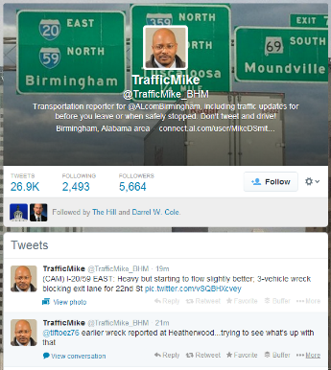
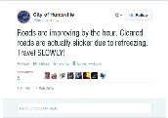
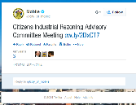
Your Customers Are Social
90% of DOTs Use Social Media
As Do Many Other Public Agencies
Source: AASHTO Fourth Annual State DOT Social Media Survey (October 2013)
Notes:
So, getting back to the business case, once you’ve decided that it does make sense to dedicate at least some attention to social media. The next step is figuring out where to go. What do you want to do? Based on the raw numbers, some degree of presence on Facebook and Twitter makes a lot sense. According to AASHTO’s 2013 State DOT Social Media Survey, 90% of state DOTs use both Twitter and Facebook to share information with the public.
They use them for emergency alerts (particularly Twitter) and for sending other information to drivers. Al-DOT, however is not (yet) one of those agencies. But there are relevant public agencies in the state who are active on social media, including public works and other city agencies in Montgomery, Mobile, and Huntsville; as well as traffic reporters. Developers, big-box retailers, universities, and others are all present on social media, and even if Al-DOT isn’t active on social media it’s a good bet that Al-DOT staffers are …

Slide 13
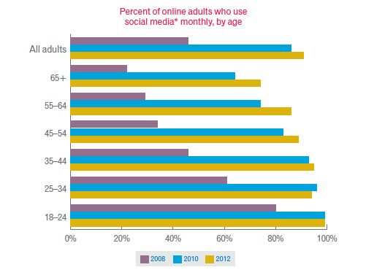
Kids These Days
Nearly 100% of Millennials
Well Over 90% of Gen X
Over 80% of Baby Boomers
Use Social Media Monthly
Source: Experian Marketing Services, 2013 Digital Marketer Report
Notes:
… Each year more and more people in every age group start using social media. If you take the definition of “Millennial” as someone born since 1980 (everyone in the bottom two bars here), Experian’s research finds that pretty much all of them use a social network monthly. Add in the Generation X folk in the next bracket or so up, it’s still in the 90 percent plus range. You have to look to those people born in 1948 or earlier before monthly social media usage drops below 80 percent of those surveyed
So even if you aren’t using social media, it’s highly likely that people you do business with -- or will be doing business with in the coming years -- are.

Slide 14
Sketch Out a Plan
Notes:
So, since people are likely to look for you where they are, being on Facebook and Twitter makes a certain degree of sense. Pinterest and Instagram give you different ways to share pictures, for example of ongoing projects. It’s a softer sort of connection, but it draws attention to the good work you do. Similarly, YouTube is great for sharing informative videos or commercials. Google Plus is less heavily used, but it is another place that will show up in searches.
LinkedIn can be used two ways: To promote your company and to promote you. I’ll talk more about building your personal brand in a moment, but for companies it makes sense to set up a company page on LinkedIn that you can use in recruiting, to communicate with employees, and to promote your services or projects.
All of these social media outlets are free to use, so it’s worth signing up for an account and poking around. See what network or combination of networks appeals to you and fits your operations. Look at what your customers and competitors are doing.

Slide 15
Putting It Into Action
Right People
Right Tools
Right Plan
Seems Pretty Simple
Notes:
Once you’re ready to move beyond exploration, you need to figure out who in your company is responsible for keeping your social media profiles going. Decide how active you want things to be — is it one tweet or post a week? Is it several a day? You don’t have to be rigid, but having an idea of what you expect will help in figuring out the next question: Who’s going to do this? If you are a large company, do you have different accounts for different divisions? Or is all social media handled through a central office?
You want to find someone you trust as a public face for your organization. If you have a marketing person or someone else who handles communications, that person is likely the one who is responsible for your social media presence or at least they will be overseeing and working with that person.
Once you know who is in charge of social media, and you’ve given them parameters for what you want to see posted, the next thing is finding the tools that can make managing social networks easier. This can range from making sure they have a robust smartphone that can be used to take pictures and make posts from the field to programs or apps like HootSuite, which make it easy to schedule posts ahead of time.
Finally, make sure you have a plan. Know what you want to see posted and who should be doing the posting, and communicated that broadly to the company.
It’s like any part of business: You need the right people with the right tools to execute the right plan.

Slide 16
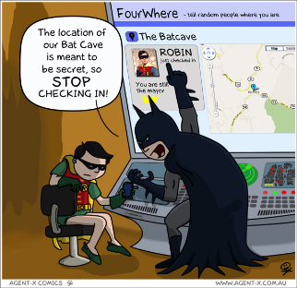
Social Media Guidelines
Who is Authorized to Post for the Company?
Company Information on Employee Accounts
Handling Criticism
Comic by Agent-X Comics, used under a Creative Commons license
Notes:
Beyond a proactive plan for your own social media efforts, you also need to a social media policy for employees. If there’s an accident at a jobsite, you want to make sure everyone knows that it is not their job to post pictures to Facebook. At the same time, particularly if the incident occurs in a visible place, you may need to respond on social media. Just like a call from the local TV station, have a plan for how to respond if someone is making comments about your company online, and make sure employees know who to alert (and who is authorized to respond) if they see something posted about your company.
Which raises another issue. Some companies try to place limits about what employees say about their company online. This can be difficult to police effectively and in some jurisdictions may raise legal issues. I’m not an HR lawyer, and none of this is legal advice, but if you do develop a written social media guidelines as part of your employee handbook, it’s probably best to aim for something that balances a right to post with a shared responsibility to protect the company’s image and remind employees to use their best judgment. Having employees spread positive messages about your company through their networks can benefit you, but they should be able to tell the difference between appropriate and inappropriate sharing.
And then there’s interaction with the public. For good and for bad, people post all sorts of things online. At some point an unhappy customer may post something unkind on your Facebook wall. Or a happy one may tweet something really nice. In either case, decide whether or not you need to respond, but do so is a reasoned way. Usually a brief, civil reply is best, and then take any specifics to a private message.

Slide 17
Find Your Voice
Don’t Just Sell
40:40:20
Be Personable
Spend Time Listening
Photo by Amber N. Ambrose, used under a Creative Commons license
Notes:
There are a lot of metaphors out there to describe social media, but one I think most people can get pretty quickly is that social media is like a cocktail party or a networking event. You want to show up, hopefully meet some interesting people, and, by the time it’s over, leave a good impression on the people you met.
I mentioned this earlier, but it’s worth restating: When someone likes your page on Facebook or follows you on Twitter, they’ve invited you into their online home. Don’t be a bore who does nothing but shout sales pitches. There’s an old direct marketing formula that also applies to social media: 40-40-20. About 40 percent of what you post should be sharing of information; about 40 percent should be interaction; and only about 20 percent should be self-promotion.
Sometimes the lines aren’t perfectly clear, and that’s okay. A video of a paving crew in action can serve a promotional purpose, but it’s really part of that other 80 percent, either sparking interactions or sharing information. You can talk about advances in asphalt technology – Thinlays, warm mix, or high RAP/RAS mixes, for example – in way that informs people about the advantages of asphalt … as well as how you are putting them into practice.
You can also talk about important issues like highway funding. Most national (and many state and local) politicians are on social media. You can engage with them and highlight issues of concern to you through social media very easily, and hopefully spur your followers to also engage with lawmakers on these issues.
You also should be personable online. Just like at a party, talking sports or the weather or other events can help break the ice and let’s a bit of the human side show through.
And finally, listen. If people post comments on your page or you see something interesting on theirs, reply and, when it makes sense, keep the conversation moving forward.

Slide 18
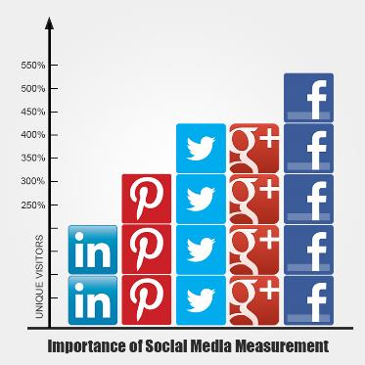
Is It Working?
Goals & Expectations
Metrics
ROI
Source: Social Metrics, http://socialmetricspro.com/social-media/importance-of-social-media-measurement/2049/
Notes:
So, how do you decide if what you’re doing is working? You will rarely see a clear, direct line between social media efforts and sales. It’s a softer touch than that, and you have to have realistic goals and clear expectations. Is it that you expect to see a certain number of followers, or does it matter more who’s following you? If you have a few city engineers or pavement designers, maybe a few traffic reporters, among your followers, would you consider that a win? Or do you have to have several hundred followers and it doesn’t matter who they are. Again, it comes back to your business case as to what you want to achieve.
As for metrics, there is a good deal of information built into social networks. Most of them put the number of Likes or Followers front and center, which gives you a blunt view of your reach. On Facebook pages, you can get a little more granular and see how people are responding to different posts, as well as track interactions over time. If you are pushing traffic from Twitter or Facebook to your website, you can see what sort of content does the best job of driving traffic.
And all those bits of information have to be used to decide if the return you’re getting – in terms of followers or interactions or sales calls or whatever – is worth the time it takes. And if it isn’t readjust your efforts. Social media is like any other aspect of your business: you have to evaluate what’s working and what’s not, and be willing to make changes.

Slide 19
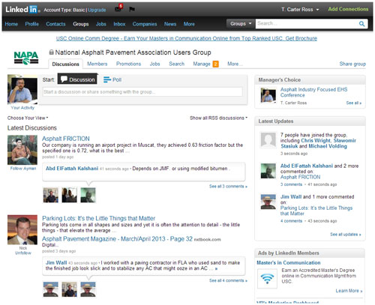
What About Me?
Notes:
Stepping aside from corporate use of social media for a moment, I’d also like to mention how you can use social media for your own professional purposes. The three biggest social media networks in terms of users right now are Facebook, Twitter, and LinkedIn. Facebook and Twitter are pretty straightforward in their utility, but LinkedIn is a bit different and its use is growing. I mentioned before that LinkedIn has company pages where you can promote what you do, but it also is a place to promote yourself. You post your job history, your skills, and other information, and people can use that as part of looking for experts or expertise.
Less frequently used are LinkedIn Groups. These are places where you can go for discussions, to ask questions, and to get leads about new technologies or ideas. Because these groups often have members from around the world, the discussions can get quite wide ranging and they can be quite informative. I’d invite everyone here to join the NAPA Users Group on LinkedIn (just search for National Asphalt Pavement Association under groups), and add your voice to the voices there.
Similarly, there is a road construction question-and-answer site that launched in 2012, IBuildRoads.com. People ask questions about problems they’ve encountered or technologies they’re curious about, and others offer their advice or ideas. It’s a good place to demonstrate your expertise and to benefit from others’ experiences.

Slide 20
Dos and Don’ts
Do Know Where Social Media Fits in Your Business Plan
Do Have a Social Media Plan and Social Media Guidelines
Do Engage and Respond
Don’t Just Sell
Do Experiment
Don’t Leave It to Chance
Notes:
So to wrap things up, here are a few Dos and Don’ts. You want to have an idea of why you want undertake a social media campaign, and you need a plan for achieving it. You also need social media guidelines for employees, and they need to be well communicated.
Remember that social media isn’t a megaphone. You need to listen and respond; it’s not a pure sell environment, you have to educate, inform, entertain and engage ... And sell.
Finally, experiment. There’s a lot of room to give things a try with social media, but you don’t have to do everything. If you find a particular network doesn’t work for you or isn’t reaching the people you want to reach, you don’t have to keep using it. It may, however, make sense to post a final note letting people know how to reach your website or how to otherwise contact you instead of just deleting the account. That helps ensure you have control of your profile or name, even if you aren’t using that account.

Slide 21
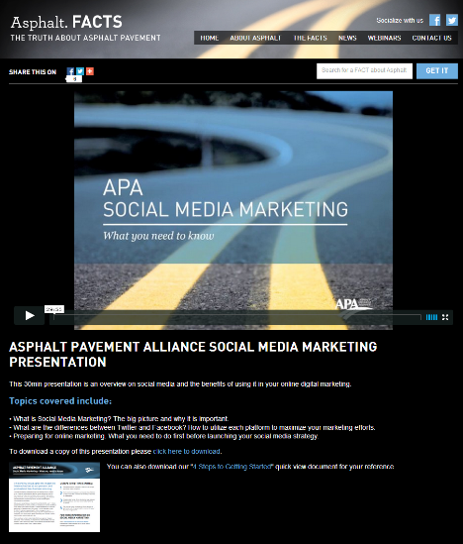
Additional Resources
Asphalt Pavement Alliance:
www.asphaltfacts.com/social-media
Notes:
If you’re looking for more information about putting social media to use, the Asphalt Pavement Alliance has a video presentation and handout about social media marketing that free and accessible via the AsphaltFACTS website, just visit www.asphaltfacts.com/social-media

Slide 22
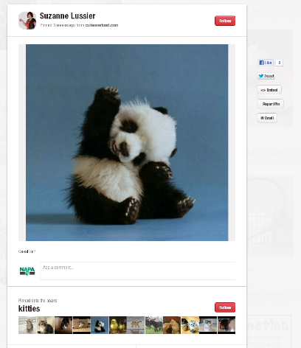
Questions & Answers
T. Carter Ross cross@asphaltpavement.org
www.AsphaltPavement.org www.facebook/AsphaltPavement @NAPAtweets
Notes:
So, thank you very much. I realize the reception will start soon, but if you have any questions, I’d be happy to try to answer them now, or my email address is up on the screen; please feel free to contact me.

